Slide 1
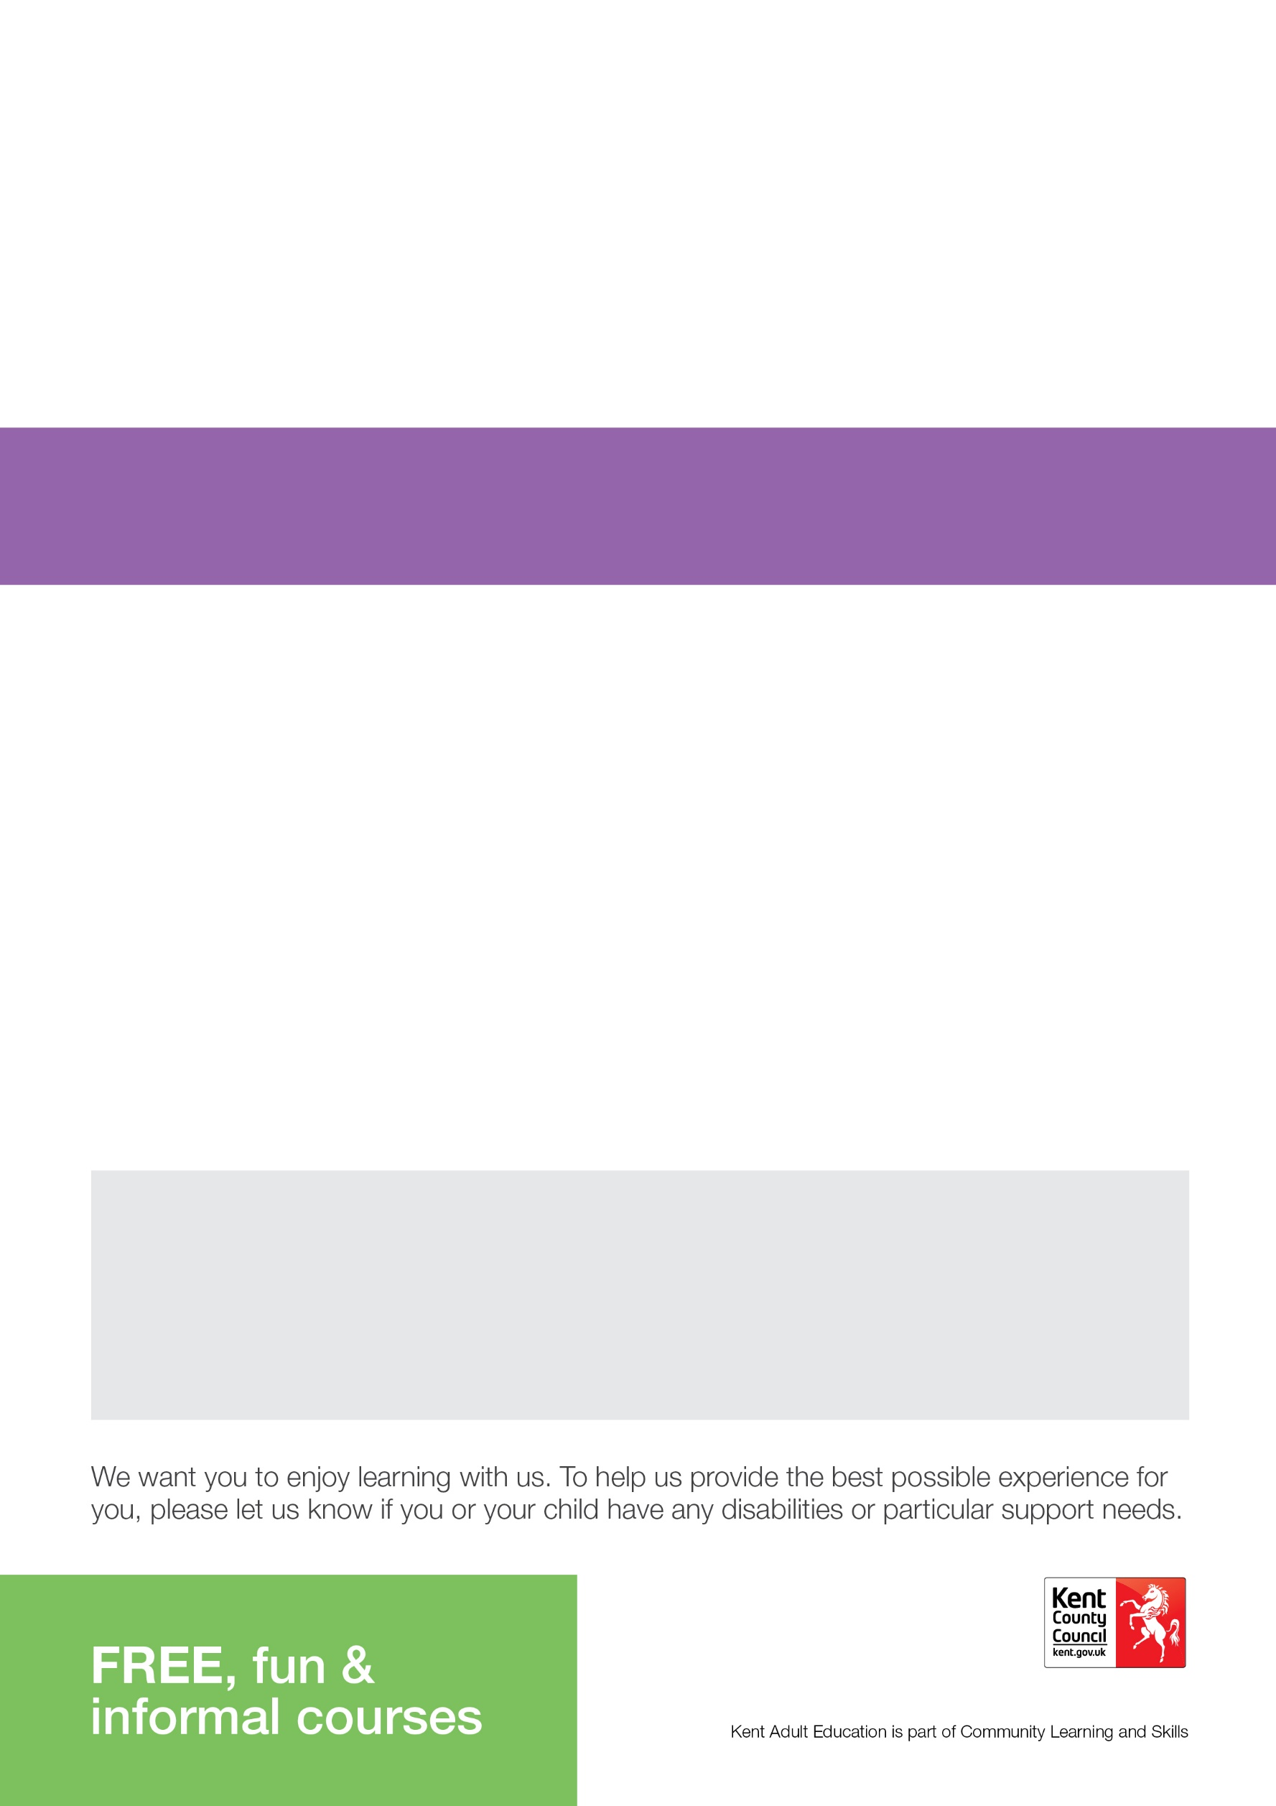

FREE Live Online Courses
starting in February and March
These courses are specifically for adults only who have not taken part in a course with Kent Adult Education since
August 1st 2020
To book a place on our FREE courses go to: www.kentadulteducation.co.uk
and click on Course Areas then Craft then General Craft

